Slide 1

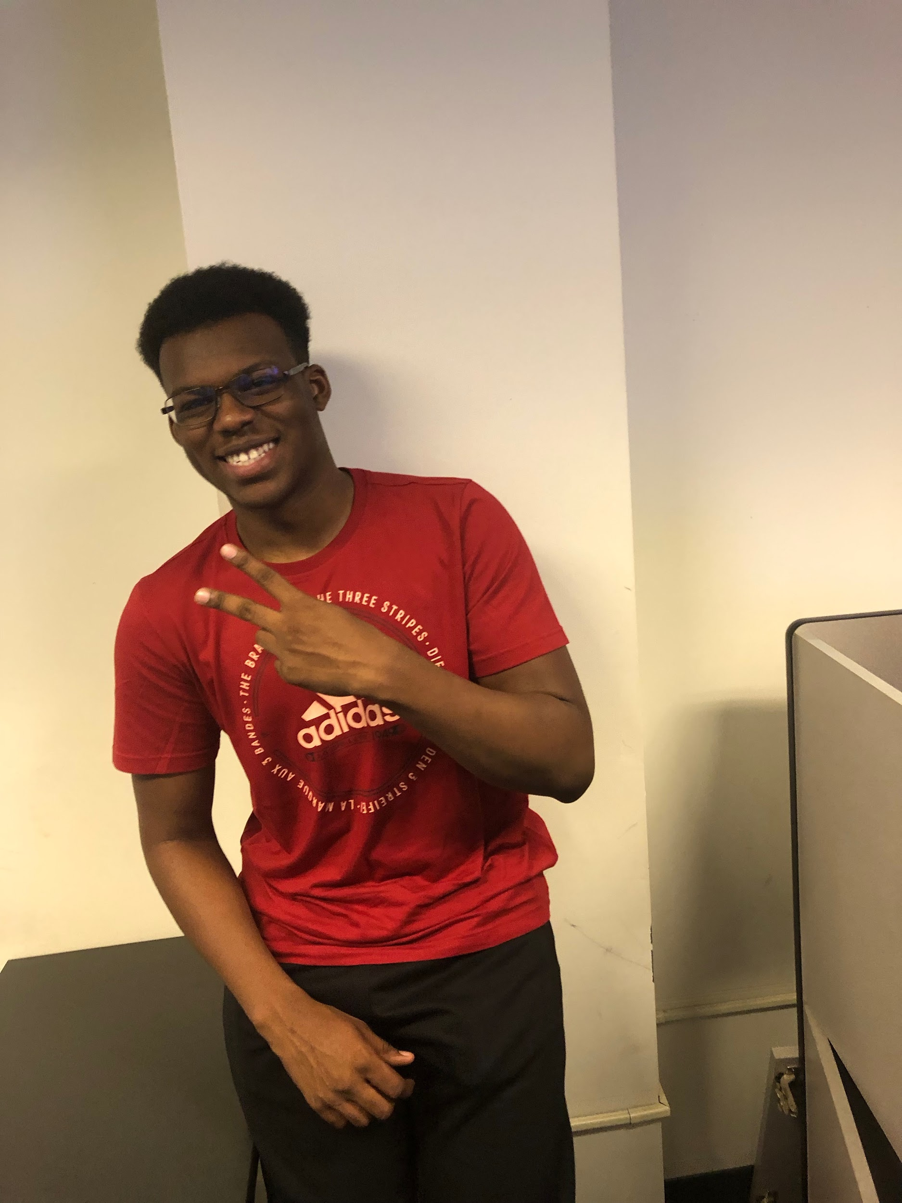

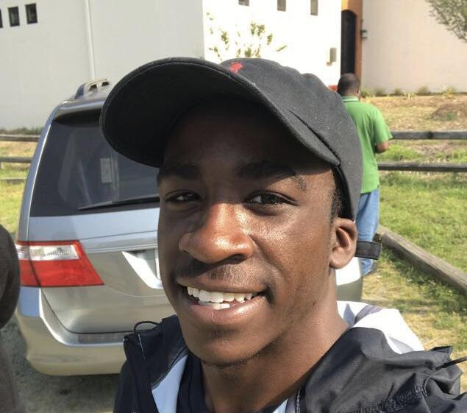

RamNation
Selected problem: COVID 19 Vaccine Sites
Virtual Background created with Adobe Spark
Abdul Mohammed
Computer Science
Junior
Donovan Benson
Computer Science
Sophomore
Luis Bueno
Computer Science Jr.
Hailey Gipson
Computer Science
Junior

Slide 2
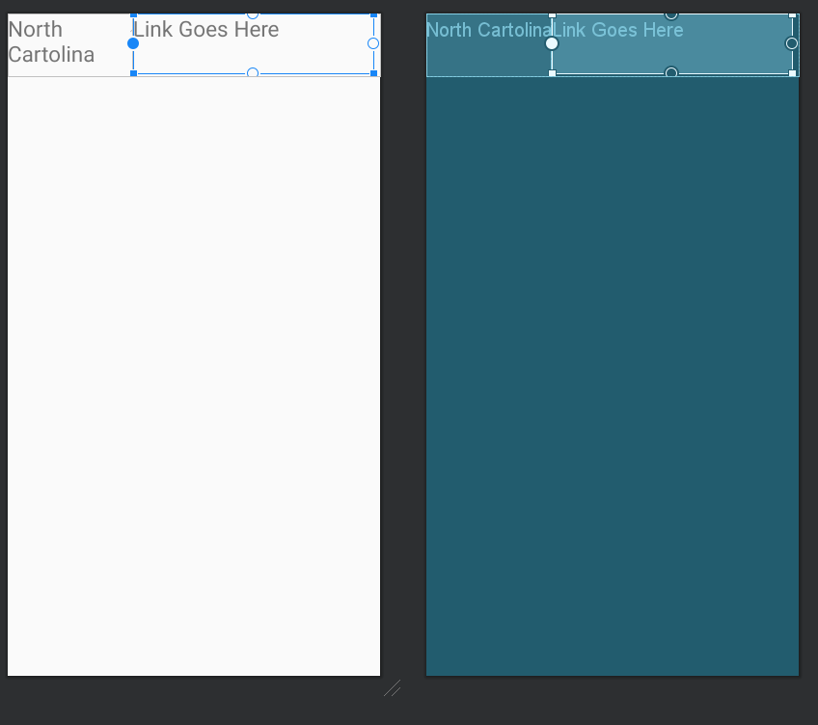
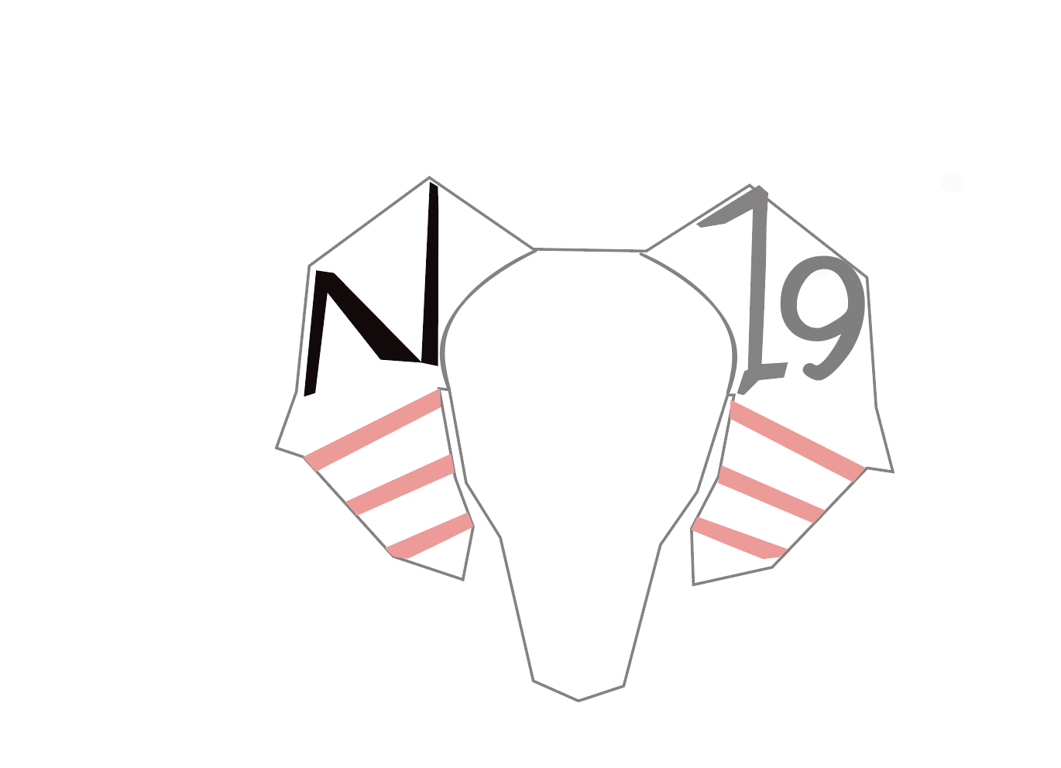
Status Update
-Created a spreadsheet containing all of the links to covid dashboards for each state
- Came up with a layout for the application design
-Created a custom logo for the application
-Working on getting the Application running with collected data

Slide 3
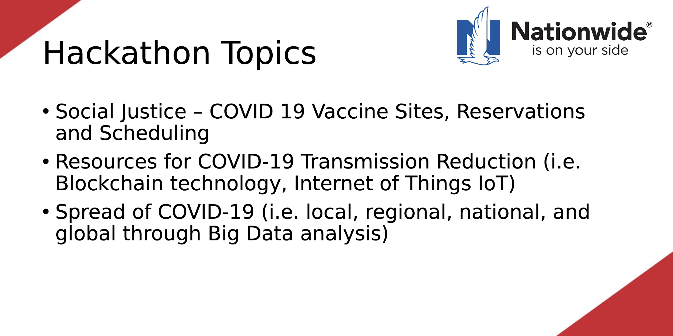
We chose the Social Justice topic for our program. We wanted to make an app that would share and give helpful information about COVID-19 Vaccine Sites for all 50 states. We know that there is lots of false information going around about the different vaccinations. There are numerous opinions about if it will help or what it really does, especially in the HBCU community. With us going to an HBCU we wanted to make something that could be beneficial to the students who may not be receiving the correct information or who may just be scared to get it.

Slide 4
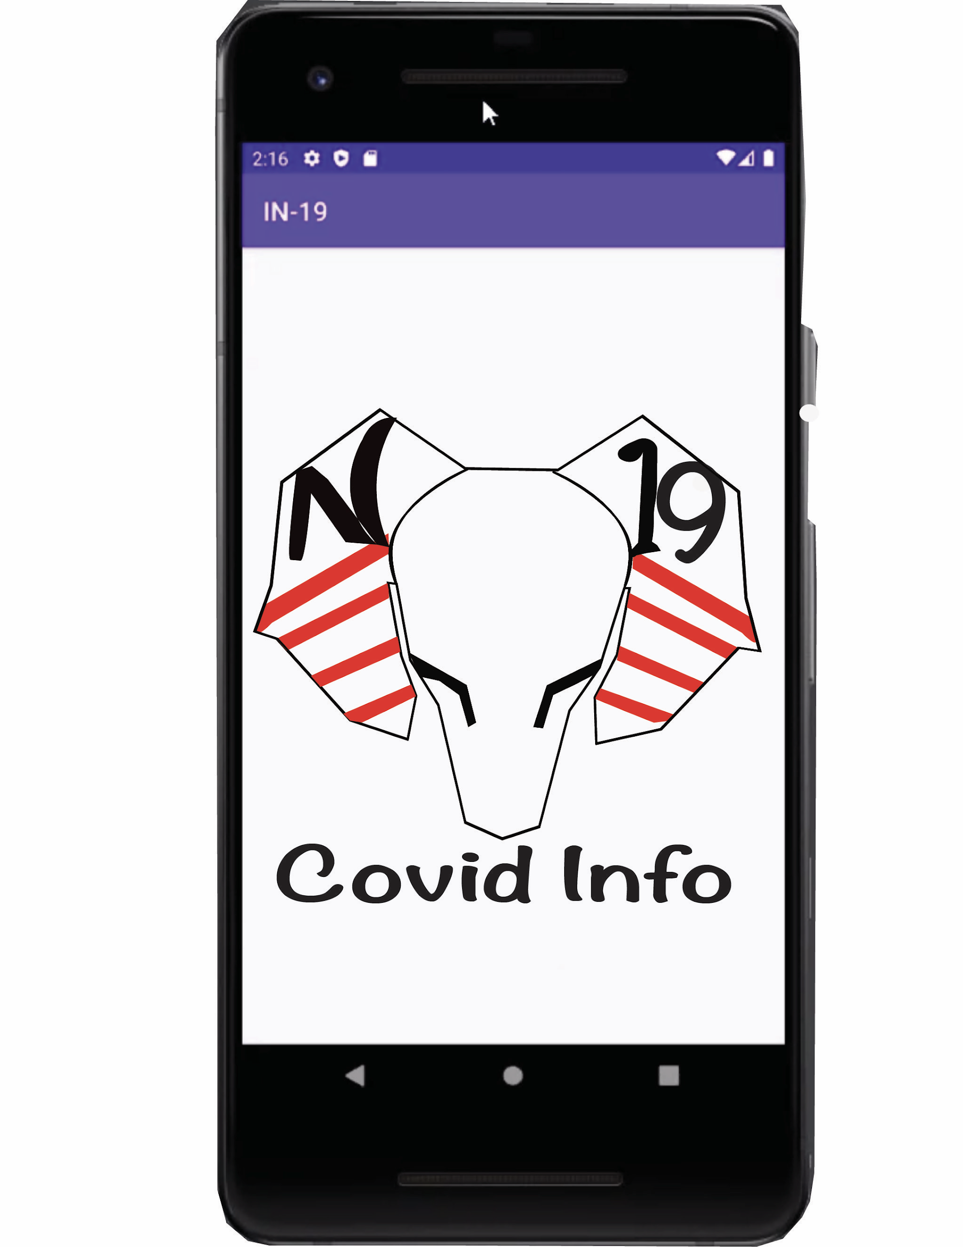
The purpose of our app was for a user to type in their state and to be redirected to trusted covid sites for information, vaccine and testing locations. Our goal was to get a functional app and then focus on the aesthetics part later. If we had more time, we would add the state flags beside each of the states, work on the improving the UI, and add the pre-registration vaccine links for the states that have them.
We worked on the app using Android Studio.

Slide 5
Live Demo

